Slide 1
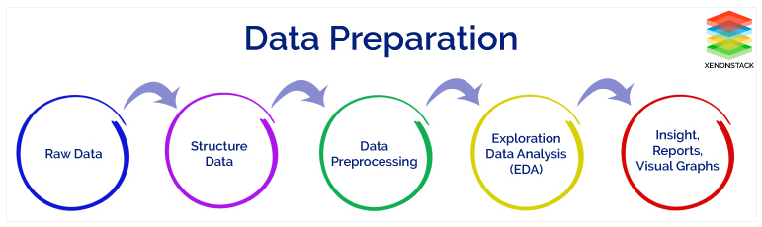
Data Preparation :
The collected data cannot be used directly for performing the analysis process. Therefore, to solve this problem Data Preparation is done.
It includes two techniques that are listed below :
1. Data Preprocessing
2. Data Wrangling
Data Preparation Architecture
It includes two concepts such as Data Cleaning and Feature Engineering. These two are compulsory for achieving better accuracy and performance
in the Machine Learning and Deep Learning projects.

Slide 2
Why is Data Preparation Important?
Data Preprocessing is necessary because of the presence of unformatted real-world data. Mostly real-world data is composed of :
1. Inaccurate data (missing data) : There are many reasons for missing data such as data is not continuously collected, a mistake in data entry, technical
problems with biometrics and much more.
2. The presence of noisy data (erroneous data and outliers) : The reasons for the existence of noisy data could be a technological problem of gadget
that gathers data, a human mistake during data entry and much more.
3. Inconsistent data : The presence of inconsistencies are due to the reasons such that existence of duplication within data, human data entry,
containing mistakes in codes or names, i.e., violation of data constraints and much more.
Therefore, to handle raw data, Data Preprocessing is performed.

Slide 3
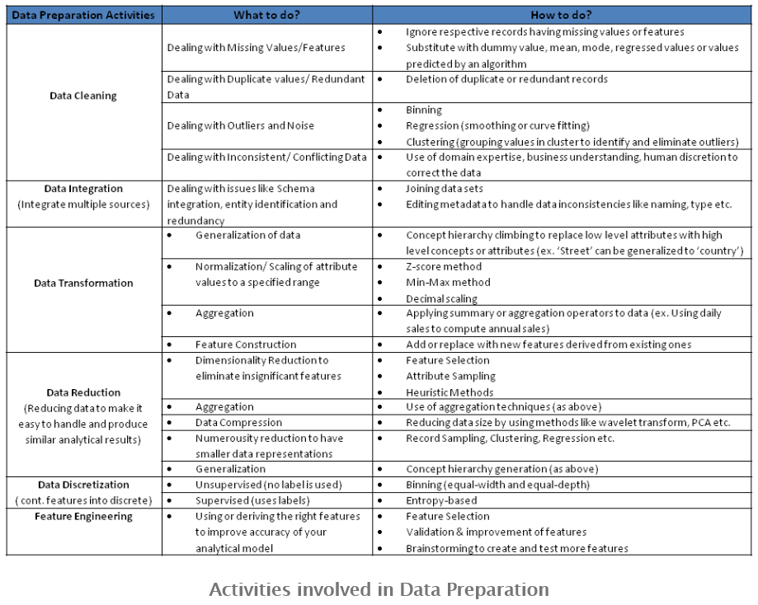

Slide 4
Data Preparation = Data Cleansing + Feature Engineering
Data preparation cannot be fully automated. Often this takes 60 to 80 percent of the whole analytical pipeline. However, it’s a mandatory task to get the best accuracy from machine learning algorithms on your datasets.
a. Data Cleansing puts data into the right shape and quality for analysis. It includes many different functions, for example the following:
1. Basics (select, filter, removal of duplicates, …)
2. Sampling (balanced, stratified, ...)
3. Data Partitioning (create training + validation + test data set, ...)
4. Transformations (normalisation, standardization, scaling, pivoting, ...)
5. Binning (count-based, handling of missing values as its own group, …)
6. Data Replacement (cutting, splitting, merging, ...)
7. Weighting and Selection (attribute weighting, automatic optimization, ...)
8. Attribute Generation (ID generation, ...)
9. Imputation (replacement of missing observations by using statistical algorithms)
b. Feature Engineering selects the right attributes to analyze. You use domain knowledge of the data to select or create attributes that make machine learning
algorithms work. Feature Engineering process includes:
1. Brainstorming or testing of features
2. Feature selection
3. Validation of how the features work with your model
4. Improvement of features if needed
5. Return to brainstorming / creation of more features until the work is done

Slide 5
